Slide 1
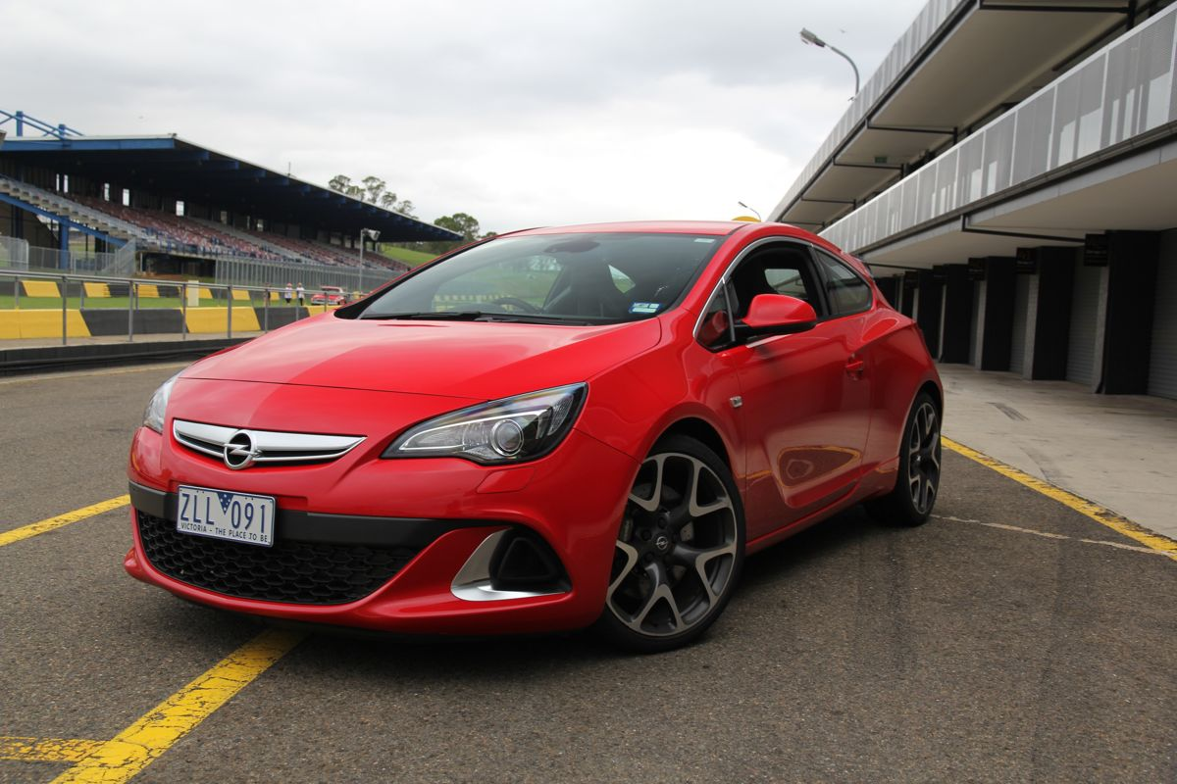
LARIAT Boosting 2019 Sales

Slide 2
Overview
Reviewing 2018 Sales
Ways to boost up 2019 Sales
Strategy 1
Strategy 2
Strategy 3
Combine all three

Slide 3
2018 Sales Recap
$64,866,040
Notes:
Total Car Revenue: $64,866,040
Total Car Costs: $33,076,688,64
Total Profit: $31,789,351.36

Slide 4
2018 Sales Recap
$64,866,040
$33,076,688
Notes:
Total Car Revenue: $64,866,040
Total Car Costs: $33,076,688,64
Total Profit: $31,789,351.36

Slide 5
2018 Sales Recap
$64,866,040
$33,076,688
$31,789,351
Notes:
Total Car Revenue: $64,866,040
Total Car Costs: $33,076,688,64
Total Profit: $31,789,351.36

Slide 6
How can we boost sales for 2019?
Notes:
(3) Strategies:
Strategy 1: Assuming company growth is consistent throughout 2019
Strategy 2: Addition and removal of cars from fleet
Strategy 3: Enforcing a 5% insurance fee on the renter’s total

Slide 7
Strategy 1: Company Growth
$81,082,550
Assume all factors stay constant and company draws in business at 25% growth
Notes:
Strategy 1:
Assume that the total cars remain constant (4000 cars)
Predicting that Company Growth is growing at a rate of +25%
We’ll see that… (aka 25% profit)
Total Car Revenue: $81,082,550
Total Car Costs: $33,076,688,64
Total Profit: $48,005,861.36

Slide 8
Strategy 1: Company Growth
$81,082,550
Assume all factors stay constant and company draws in business at 25% growth
$33,076,688
Notes:
Strategy 1:
Assume that the total cars remain constant (4000 cars)
Predicting that Company Growth is growing at a rate of +25%
We’ll see that… (aka 25% profit)
Total Car Revenue: $81,082,550
Total Car Costs: $33,076,688,64
Total Profit: $48,005,861.36

Slide 9
Strategy 1: Company Growth
$81,082,550
$48,005,861
Assume all factors stay constant and company draws in business at 25% growth
Notes:
Strategy 1:
Assume that the total cars remain constant (4000 cars)
Predicting that Company Growth is growing at a rate of +25%
We’ll see that… (aka 25% profit)
Total Car Revenue: $81,082,550
Total Car Costs: $33,076,688,64
Total Profit: $48,005,861.36

Slide 10
Strategy 2: Shifting the fleet
Top 5 Most Profitable Models
Pontiac – Grand Prix
Mercury – Grand Marquis
Lexus - LS
Add 6 cars to the top 5 profitable models
Removing the bottom 5 models that are non and least profitable
Ford - Ranger
Chevrolet – Express 3500
Notes:
Strategy 2: We are looking at the top 5 profitable car models in the company.
Pontiac – Grand Prix (23)
Mercury – Grand Marquis (23)
Lexus – LS (21)
Ford – Ranger (23)
Chevrolet – Express 3500 (20)
Goal is to add 6 ADDITIONAL cars for each of these profitable models
AND we are going to remove the 5 non profitable car models in the fleet. Those models are:
Audi – 5000CS
Daewoo – Nubira
Ford – Aspire
Plymouth – Volare
Saturn – Relay
>>> By removing (5) models, you are reducing cost and profits earned from the past year. {(Costs: -$46,084.56) + (Profits: $41,537) = }
Overall, increases our fleet to 4025 cars
Total Car Revenue: $65,327,541.15
Total Car Costs: $33,281,097.81
Total Profit: $32,046,443.34
Because we are simultaneously removing and adding car models to the fleet, the profit is not as significant. It is 0.71% change.

Slide 11
Strategy 2: Shifting the fleet
Least Profitable
Ford - Aspire
Non-Profitable
Daewoo - Nubira
Audi – 5000CS
Add 6 cars to the top 5 profitable models
Removing the bottom 5 models that are non and least profitable
Saturn - Relay
Plymouth - Volare
Notes:
Strategy 2: We are looking at the top 5 profitable car models in the company.
Pontiac – Grand Prix (23)
Mercury – Grand Marquis (23)
Lexus – LS (21)
Ford – Ranger (23)
Chevrolet – Express 3500 (20)
Goal is to add 6 ADDITIONAL cars for each of these profitable models
AND we are going to remove the 5 non profitable car models in the fleet. Those models are:
Audi – 5000CS
Daewoo – Nubira
Ford – Aspire
Plymouth – Volare
Saturn – Relay
>>> By removing (5) models, you are reducing cost and profits earned from the past year. {(Costs: -$46,084.56) + (Profits: $41,537) = }
Overall, increases our fleet to 4025 cars
Total Car Revenue: $65,327,541.15
Total Car Costs: $33,281,097.81
Total Profit: $32,046,443.34
Because we are simultaneously removing and adding car models to the fleet, the profit is not as significant. It is 0.71% change.

Slide 12
Strategy 2: Shifting the fleet
$65,327,541
Add 6 cars to the top 5 profitable models
Removing the bottom 5 models that are non and least profitable
Notes:
Strategy 2: We are looking at the top 5 profitable car models in the company.
Pontiac – Grand Prix (23)
Mercury – Grand Marquis (23)
Lexus – LS (21)
Ford – Ranger (23)
Chevrolet – Express 3500 (20)
Goal is to add 6 ADDITIONAL cars for each of these profitable models
AND we are going to remove the 5 non profitable car models in the fleet. Those models are:
Audi – 5000CS
Daewoo – Nubira
Ford – Aspire
Plymouth – Volare
Saturn – Relay
>>> By removing (5) models, you are reducing cost and profits earned from the past year. {(Costs: -$46,084.56) + (Profits: $41,537) = }
Overall, increases our fleet to 4025 cars
Total Car Revenue: $65,327,541.15
Total Car Costs: $33,281,097.81
Total Profit: $32,046,443.34
Because we are simultaneously removing and adding car models to the fleet, the profit is not as significant. It is 0.71% change.

Slide 13
Strategy 2: Shifting the fleet
$65,327,541
Add 6 cars to the top 5 profitable models
Removing the bottom 5 models that are non and least profitable
$33,281,097
Notes:
Strategy 2: We are looking at the top 5 profitable car models in the company.
Pontiac – Grand Prix (23)
Mercury – Grand Marquis (23)
Lexus – LS (21)
Ford – Ranger (23)
Chevrolet – Express 3500 (20)
Goal is to add 6 ADDITIONAL cars for each of these profitable models
AND we are going to remove the 5 non profitable car models in the fleet. Those models are:
Audi – 5000CS
Daewoo – Nubira
Ford – Aspire
Plymouth – Volare
Saturn – Relay
>>> By removing (5) models, you are reducing cost and profits earned from the past year. {(Costs: -$46,084.56) + (Profits: $41,537) = }
Overall, increases our fleet to 4025 cars
Total Car Revenue: $65,327,541.15
Total Car Costs: $33,281,097.81
Total Profit: $32,046,443.34
Because we are simultaneously removing and adding car models to the fleet, the profit is not as significant. It is 0.71% change.

Slide 14
Strategy 2: Shifting the fleet
$65,327,541
Add 6 cars to the top 5 profitable models
Removing the bottom 5 models that are non and least profitable
$33,281,097
$32,046,443
Notes:
Strategy 2: We are looking at the top 5 profitable car models in the company.
Pontiac – Grand Prix (23)
Mercury – Grand Marquis (23)
Lexus – LS (21)
Ford – Ranger (23)
Chevrolet – Express 3500 (20)
Goal is to add 6 ADDITIONAL cars for each of these profitable models
AND we are going to remove the 5 non profitable car models in the fleet. Those models are:
Audi – 5000CS
Daewoo – Nubira
Ford – Aspire
Plymouth – Volare
Saturn – Relay
>>> By removing (5) models, you are reducing cost and profits earned from the past year. {(Costs: -$46,084.56) + (Profits: $41,537) = }
Overall, increases our fleet to 4025 cars
Total Car Revenue: $65,327,541.15
Total Car Costs: $33,281,097.81
Total Profit: $32,046,443.34
Because we are simultaneously removing and adding car models to the fleet, the profit is not as significant. It is 0.71% change.

Slide 15
Strategy 3: Mandatory Fee of 5%
$68,109,342
- Enforce a mandatory 5% fee to cover potential losses caused from accidents
Notes:
Strategy 3: Enforcing mandatory 5% insurance fee on all renter’s total. This can range from (0-10%).
Reason: Ensures the safety of the rider. Let’s say if the renter is reliable with a clean license, they can be omitted from the contributing if they provide proof. If not, we charge the fee to insure them.
All fees will apply to the renter’s, so 5% will get added to their total.
Total Car Revenue: $68,109,342
Total Car Costs: $33,076,688,64
Total Profit: $35,032,653.36

Slide 16
Strategy 3: Mandatory Fee of 5%
$68,109,342
- Enforce a mandatory 5% fee to cover potential losses caused from accidents
$33,076,688
Notes:
Strategy 3: Enforcing mandatory 5% insurance fee on all renter’s total. This can range from (0-10%).
Reason: Ensures the safety of the rider. Let’s say if the renter is reliable with a clean license, they can be omitted from the contributing if they provide proof. If not, we charge the fee to insure them.
All fees will apply to the renter’s, so 5% will get added to their total.
Total Car Revenue: $68,109,342
Total Car Costs: $33,076,688,64
Total Profit: $35,032,653.36

Slide 17
Strategy 3: Mandatory Fee of 5%
$68,109,342
- Enforce a mandatory 5% fee to cover potential losses caused from accidents
$33,076,688
$35,032,653
Notes:
Strategy 3: Enforcing mandatory 5% insurance fee on all renter’s total. This can range from (0-10%).
Reason: Ensures the safety of the rider. Let’s say if the renter is reliable with a clean license, they can be omitted from the contributing if they provide proof. If not, we charge the fee to insure them.
All fees will apply to the renter’s, so 5% will get added to their total.
Total Car Revenue: $68,109,342
Total Car Costs: $33,076,688,64
Total Profit: $35,032,653.36

Slide 18
To maximize revenue for 2019…

Slide 19
…combine all 3 strategies

Slide 20

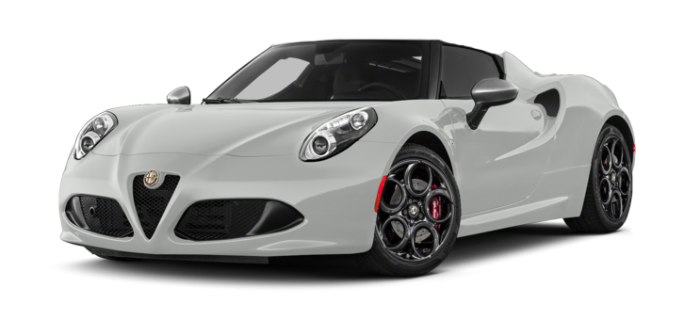

Increase When Combining All Strategies
Company Growth: 25%
Add/Removal of Models: 0.71%
Mandatory Fees: 5%
30.71% Increase in Revenue
This Photo by Unknown Author is licensed under CC BY-NC

Slide 21
Combination Strategy
$84,787,353
- Combining all (3) suggested Strategies
Notes:
Combination of 3 strategies:
Total Revenue: $84,787,353.15
Total Car Costs: $33,281,097.81
Total Profits: $51,506,255.34

Slide 22
Combination Strategy
$84,787,353
- Combining all (3) suggested Strategies
$33,381,097
Notes:
Combination of 3 strategies:
Total Revenue: $84,787,353.15
Total Car Costs: $33,281,097.81
Total Profits: $51,506,255.34

Slide 23
Combination Strategy
$84,787,353
$51,506,225
- Combining all (3) suggested Strategies
$33,381,097
Notes:
Combination of 3 strategies:
Total Revenue: $84,787,353.15
Total Car Costs: $33,281,097.81
Total Profits: $51,506,255.34

Slide 24
Questions or Comments?

